Slide 1
OpenVINO Workshop
Sept. 2018

Slide 2
Optimizing Computer Vision Applications

Slide 3
Optimizing Inference Applications
Model optimizer: tune parameters.
Use/train a model with the right performance/accuracy tradeoffs. Performance differences between models can be bigger than any optimization you can do at the inference app level.
Use an optimized inference implementation. Performance difference between using the inference engine (IE) and a non-optimized framework can be bigger than differences between accelerators.
Use the right data type for your target hardware and accuracy needs.
Use async.
Don’t infer every frame if not needed.
Use Intel® VTune™ Analyzer.
Optimize the whole pipeline.

Slide 4
Model Conversion with Model Optimizer
General topology-level opts are automatic. User knobs:
Precision
Batch (SSD!)
--scale and --mean_values
--reverse_input_channels

Slide 5
1. Pick the Right Model

Slide 6
Use/Train a Model with the Right Performance plus Accuracy Tradeoffs.
Performance is based on many factors:
Topography complexity/layer implementation plus scheduling
Number of color channels (that is, RGB vs. grayscale)
Model resolution

Slide 7
Lab4-1: Range of Model Performance
Performance range of different models and HW accelerators
 | CPU ms/frame | GPU ms/frame | Intel® Movidius™ NCS ms/frame
SSD512 | 454.09 | 506.164 | 4057.36
SSD300 | 149.02 | 190.616 | 1451.15
MobileNet-SSD* | 9.14657 | 20.7472 | 82.7658
*Try below cmds to check performance on your laptop:
lab.py tutorial1 -i Cars1.mp4 -m mobilenet-ssd/ssd300/ssd512 -d CPU/GPU/MYRIAD # remember to add ‘-p FP16’ for MYRIAD

Slide 8
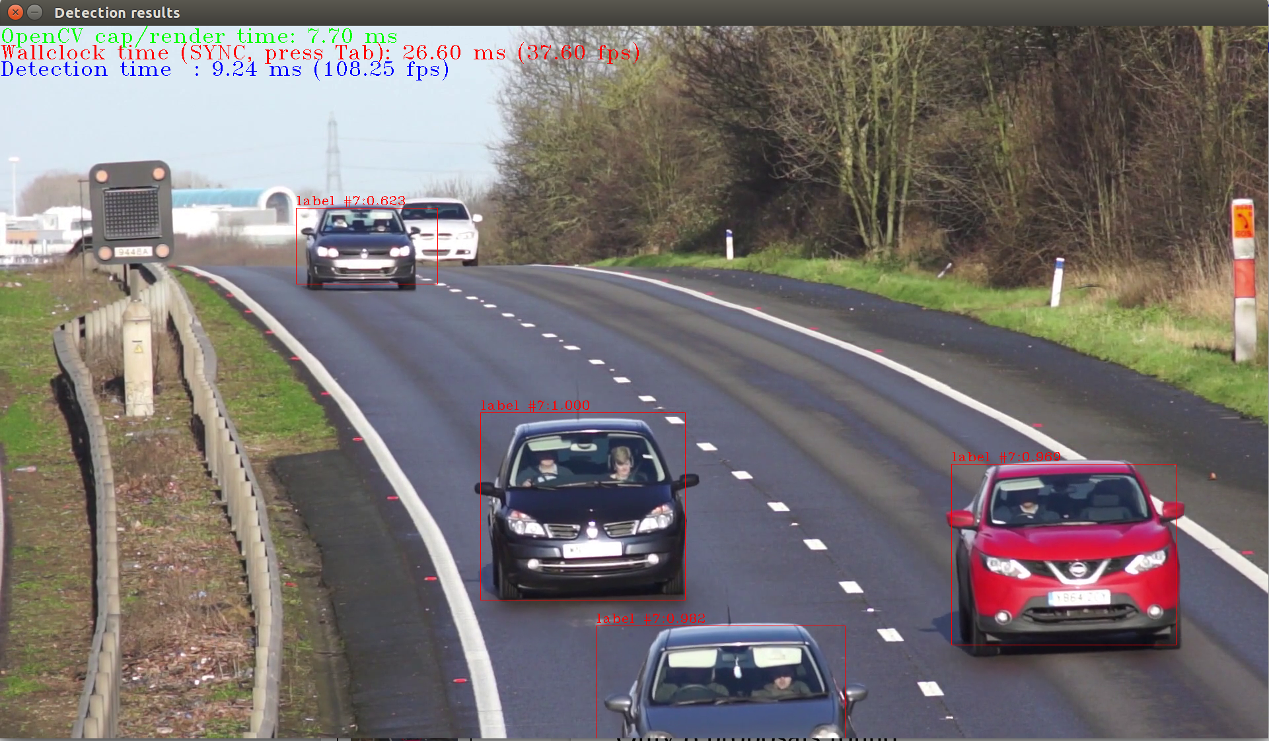
Lab4-1: Range of Model Performance
*Run below cmds and see the FPS(press “Esc” key to quit app):
lab.py object_detection_demo_ssd_async -i Cars1.mp4 -m mobilenet-ssd/ssd300/ssd512 -d CPU/GPU/MYRIAD -p FP32/FP16

Slide 9
2. Use Inference Engine

Slide 10
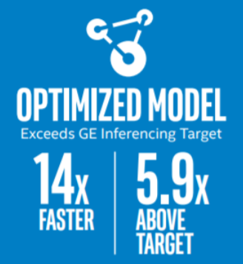
Use an Optimized Inference Implementation
vs. baseline
https://ai.intel.com/wp-content/uploads/sites/53/2018/03/IntelSWDevTools_OptimizeDLforHealthcare.pdf
The performance difference between running inference engine vs. unoptimized can be bigger than the difference between accelerators.

Slide 11
Lab4-2: Use Batch Size
Run below cmds and see how Batch Size affects performance
lab.py tutorial1 -i Cars1.mp4 -m mobilenet-ssd -d CPU/GPU -b 1/2/4/8/16
Batch | CPU ms/frame | GPU ms/frame
1 | 8.48548 | 20.6328
2 | 8.16082 | 16.5248
4 | 7.85263 | 15.3669
8 | 7.88142 | 14.9096
16 | 7.96501 | 14.4007

Slide 12
3. Use the Correct Data Type

Slide 13
3. Use the Correct Data Type
 | FP32 | FP16
CPU | yes | no
GPU | yes | recommended
Intel® Movidius™ Myriad™ | no | yes
FPGA/DLA | no | yes
*FPGA/DLA also supports FP11.

Slide 14
Lab4-3: Use the Correct Data Type
Try below cmd and see how data type affects performance:
lab.py tutorial1 -i Cars1.mp4 -m mobilenet-ssd -d GPU -p FP32/FP16
 | GPU(ms/frame)
MobileNet-SSD-FP32 | 20.6093
MobileNet-SSD-FP16 | 16.0019

Slide 15
4. Use Asynchronous API

Slide 16
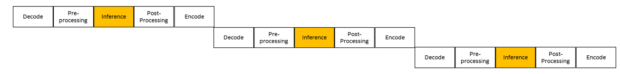
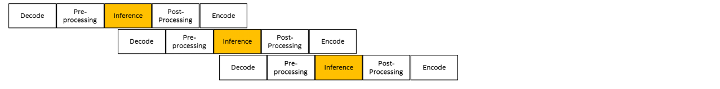
Use Asynchronous API
Assuming Inference run on the GPU (orange) and other stages on CPU (white)
Overall Pipeline will not be able to utilize the GPU and get to high frame rate.
If next frame can start processing without waiting to previous inference to finish..

Slide 17
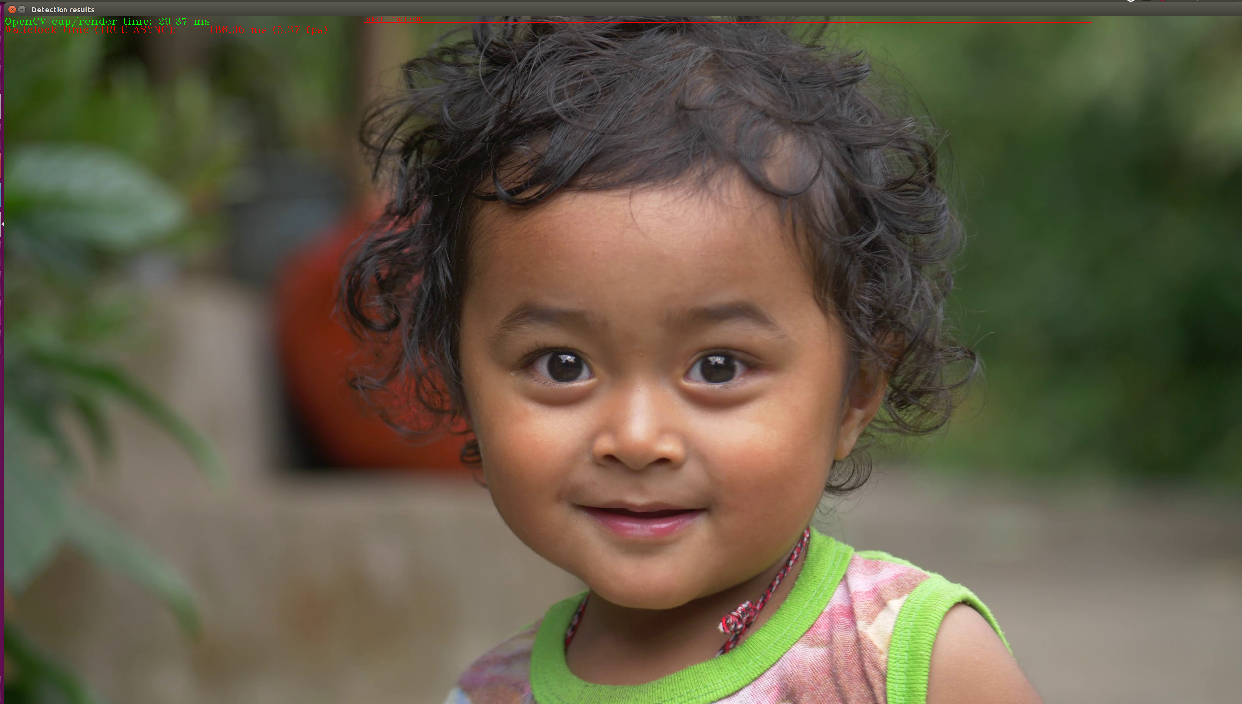
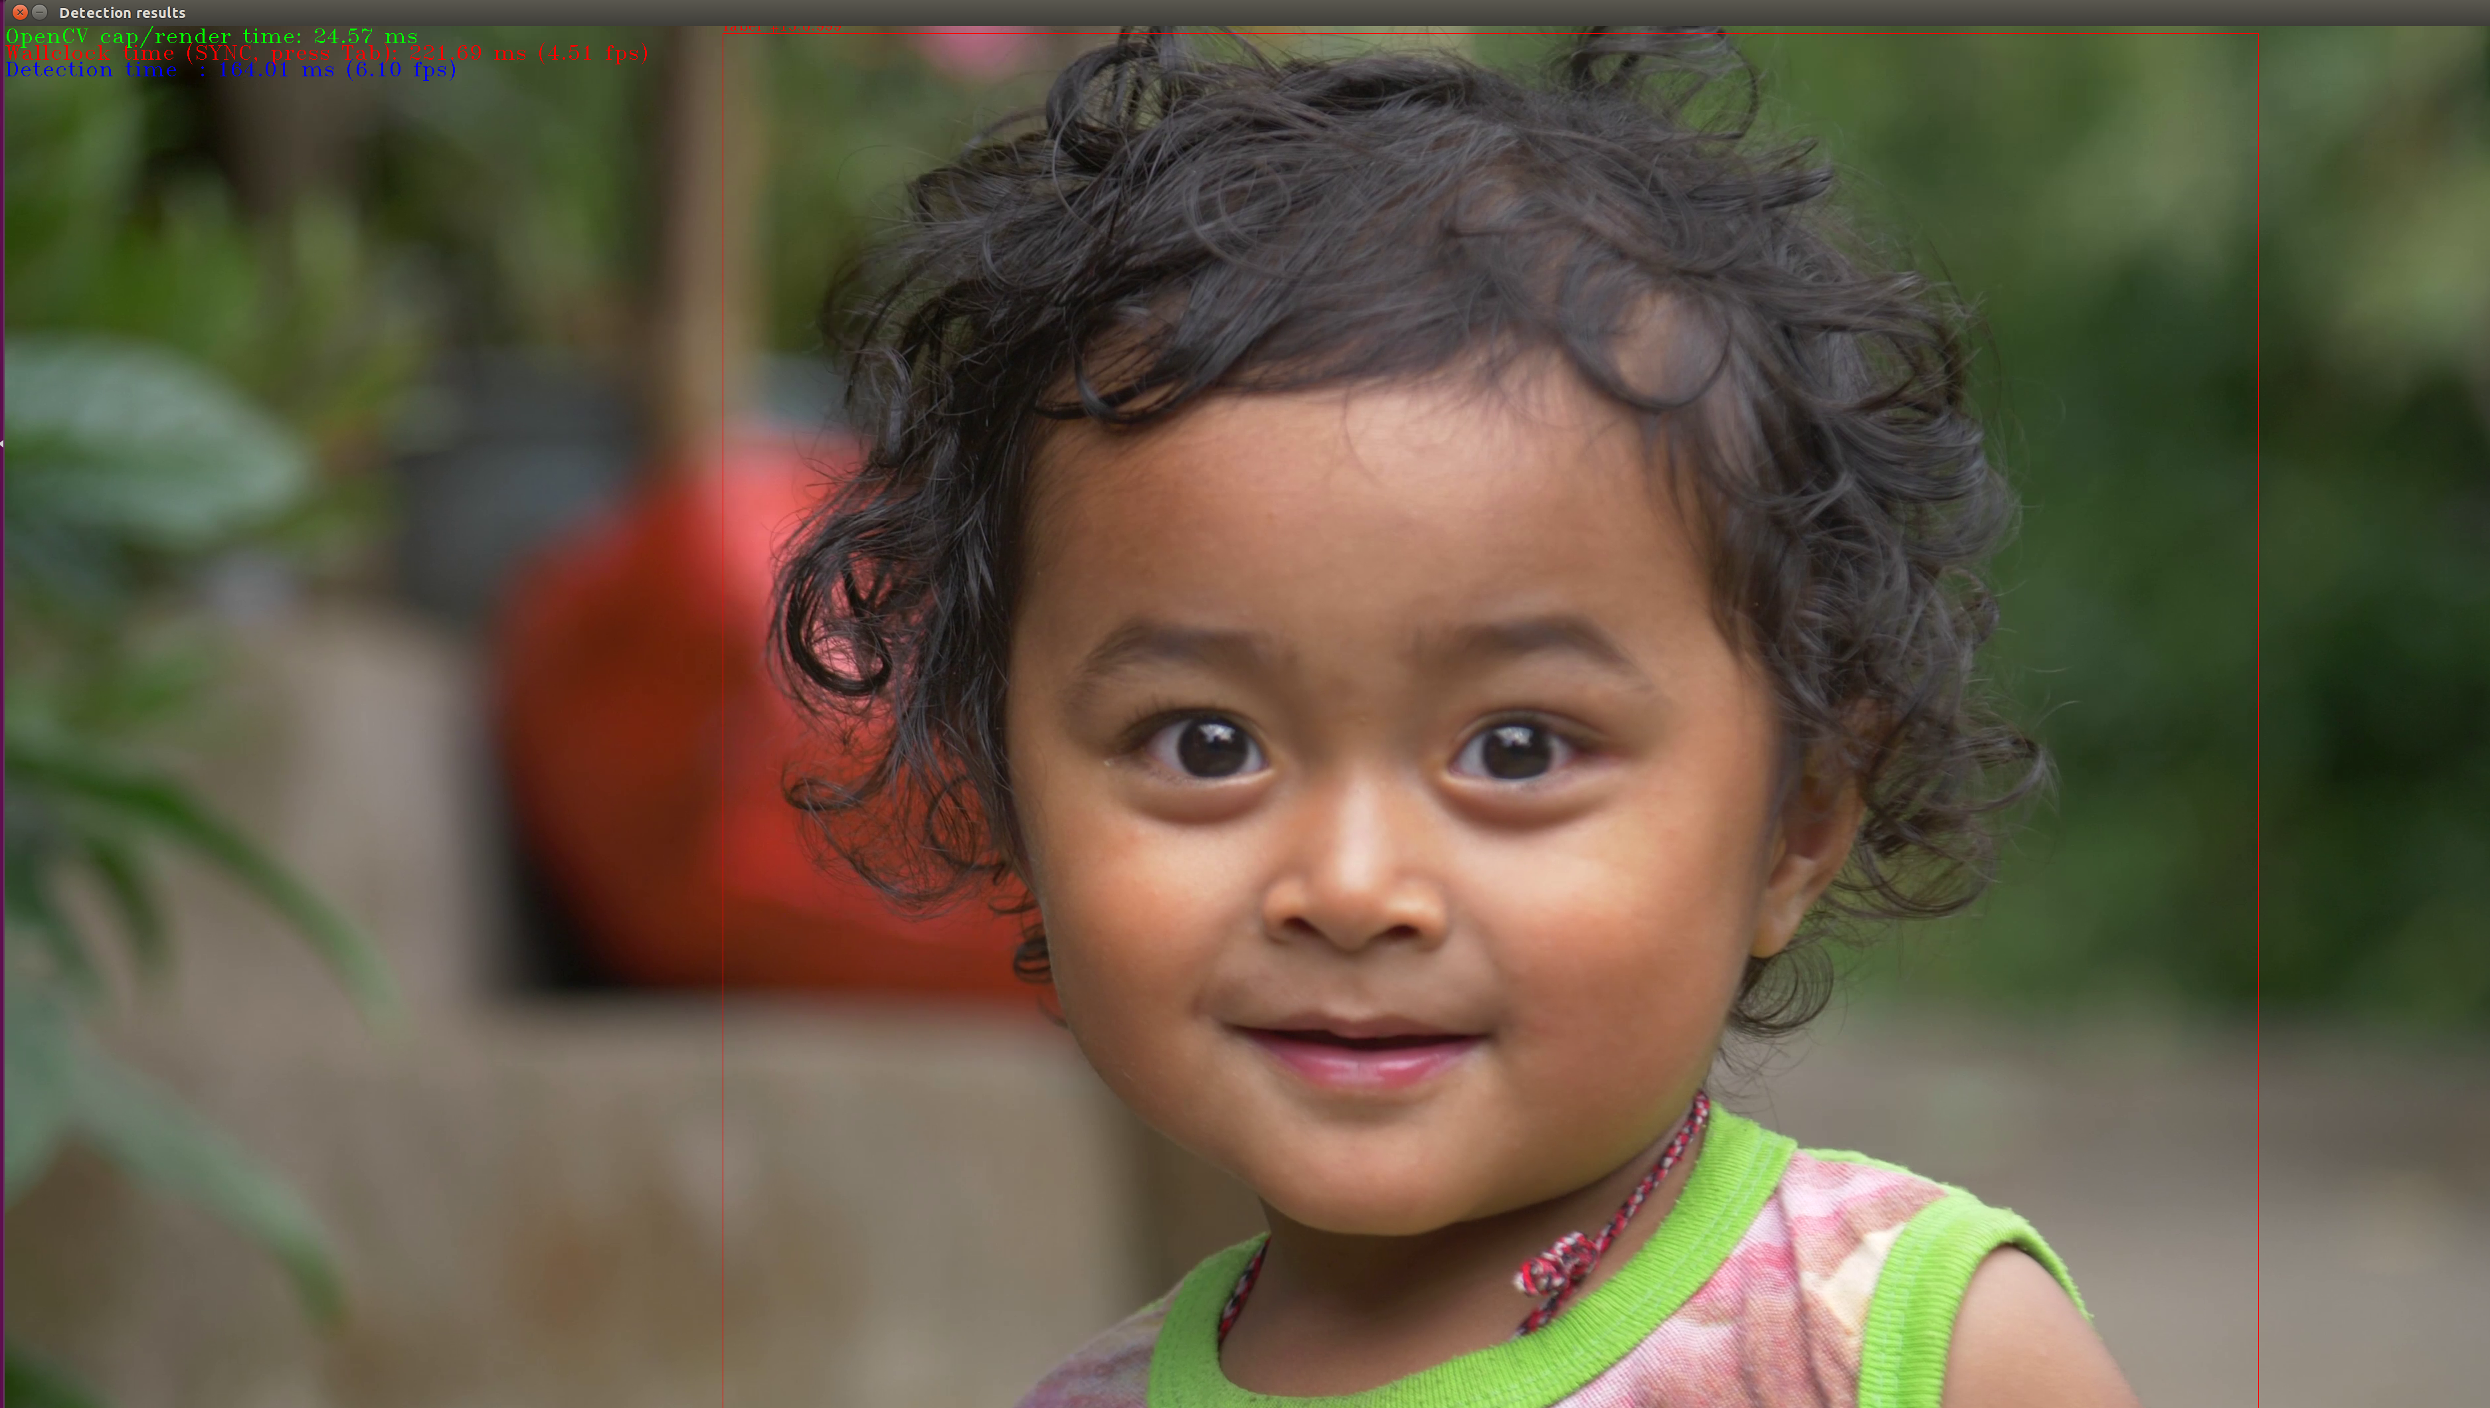
Lab4-4: Running Object Detection Sample SSD async
Try below cmd and see the performance difference with async on/off (press “Tab” key to switch on/off async, press “Esc” key to quit app)
./lab.py object_detection_demo_ssd_async -i lovely_girl.mp4 -m ssd300
* The video used in this lab comes from https://www.videvo.net

Slide 18
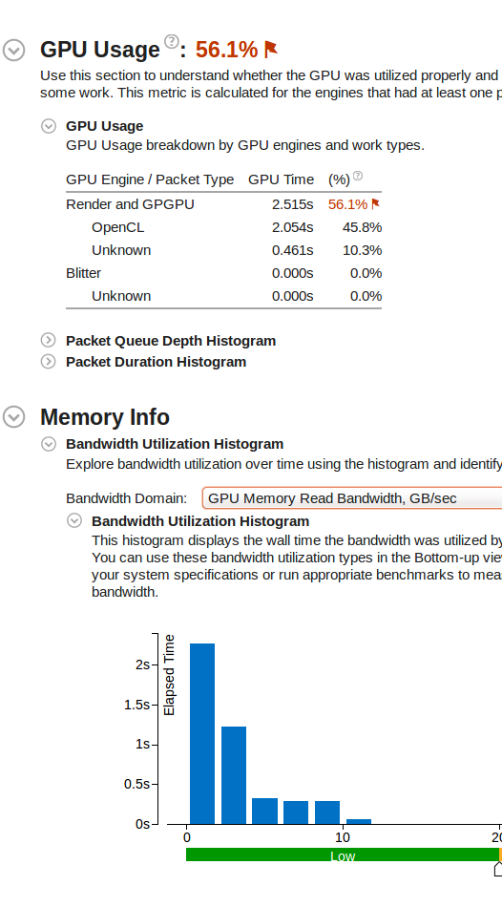
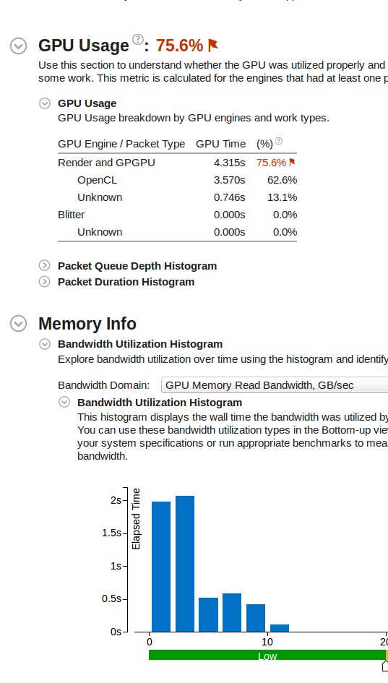
object_detection_demo_ssd_async summary
Summary view shows:
Much better GPU utilization
More memory traffic due to more inferences per second
Non-Async Mode
Async Mode

Slide 19
Advanced Video Analytics

Slide 20
Security Barrier Demo - Chaining models

Slide 21
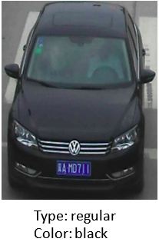
vehicle-attributes-recognition-barrier-0039 Use Case/High-Level Description
Vehicle attributes classification algorithm for a traffic analysis scenario.

Slide 22
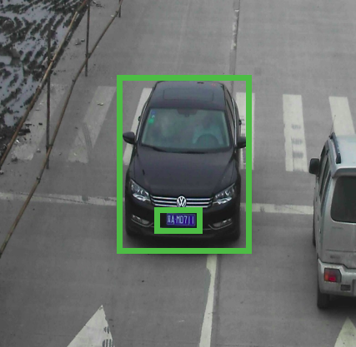
vehicle-license-plate-detection-barrier-0007 Use Case/High-Level Description
RESNET* 10 plus SSD-based vehicle and (Chinese) license plate detector for "Barrier" use case.

Slide 23
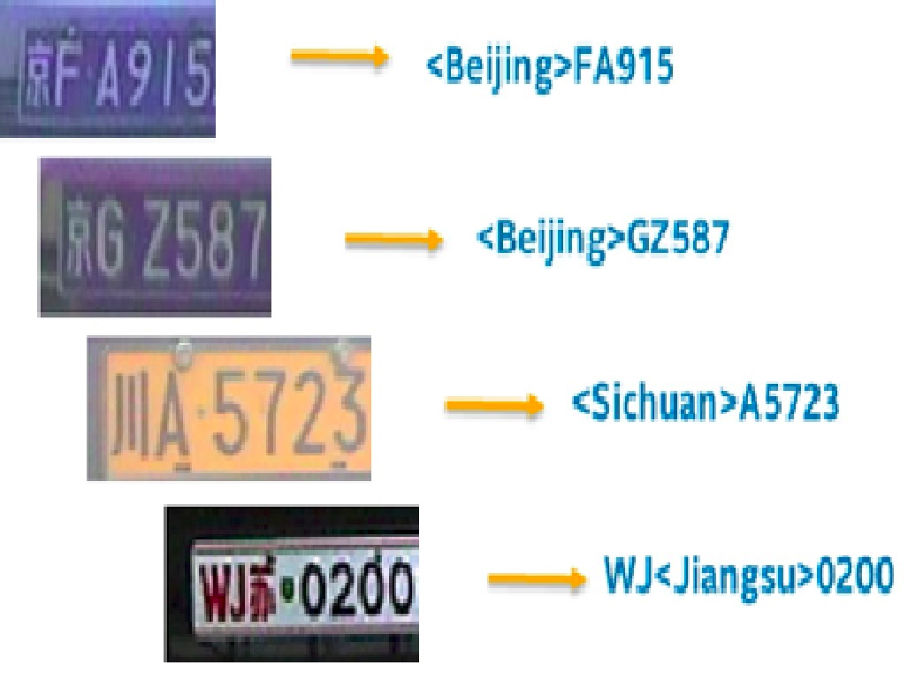
license-plate-recognition-barrier-0001 Use Case/High-Level Description
Small-footprint network trained E2E to recognize Chinese license plates in traffic scenarios.
Note: The license plates in the image are modified from the originals.

Slide 24
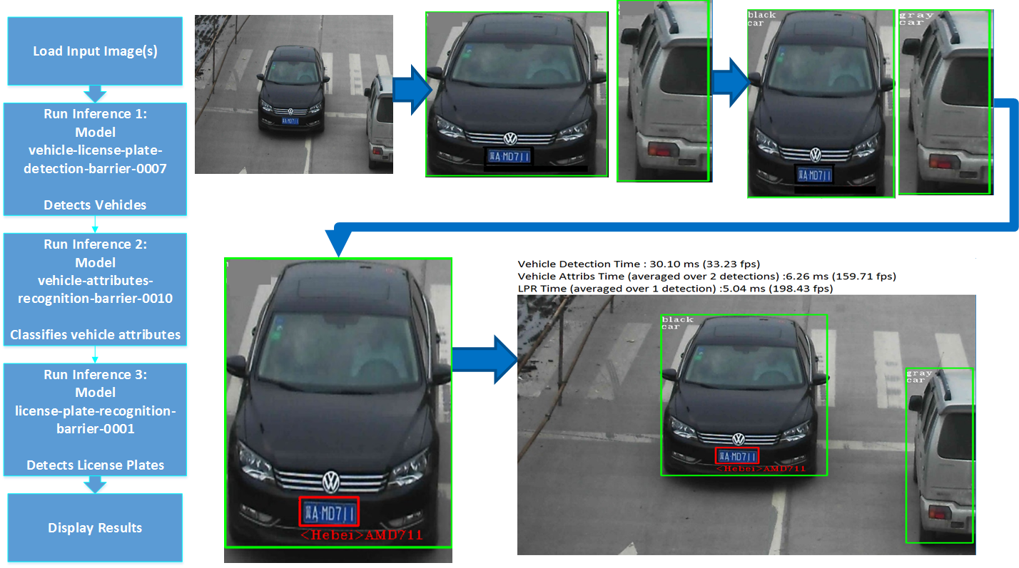

Lab5-1: Security Barrier Demo
0039

Slide 25
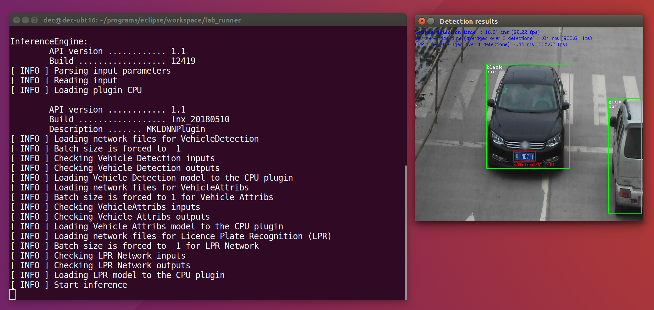
Lab5-1: Security Barrier Demo
Try below cmd and run the demo (press “Esc” key to quit app)
./lab.py security_barrier_camera_sample -d CPU -i car_1.bmp -m vehicle-license-plate-detection-barrier-0007 -m_va vehicle-attributes-recognition-barrier-0039 -m_lpr license-plate-recognition-barrier-0001

Slide 26
Face Detection Demo - Models on different hardware

Slide 27
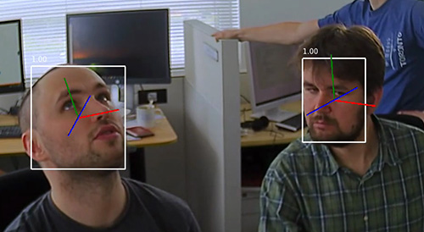
face-detection-retail-0004 Use Case/High-Level Description
The detector backbone is SqueezeNet light (half-channels) with a single-shot detector (SSD) for shooting indoor and outdoor scenes with a front-facing camera.
Find the model in this toolkit folder: \deployment_tools\intel_models\face-detection-retail-0004.

Slide 28
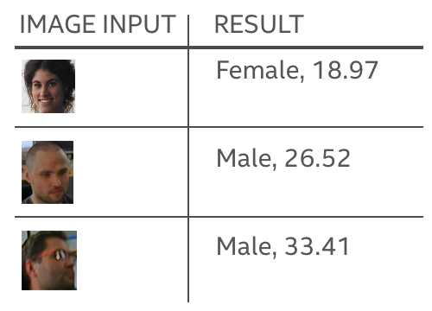
age-gender-recognition-retail-0013 Use Case/High-Level Description
This neural network-based model provides age and gender estimates with enough accuracy to help you focus your marketing efforts.
Find the model in this toolkit folder: \deployment_tools\intel_models\age-gender-recognition-retail-0013.

Slide 29
head-pose-estimation-adas-0001 Use Case/High-Level Description
This model shows the position of the head, and provides guidance on what caught the subject's attention.
Find the model in this toolkit folder: \deployment_tools\intel_models\head-pose-estimation-adas-0001.

Slide 30
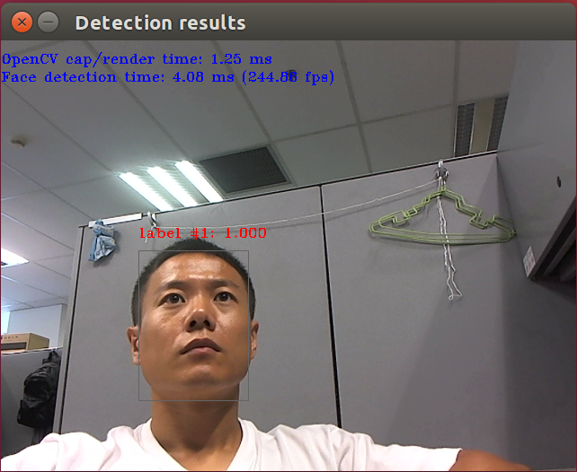
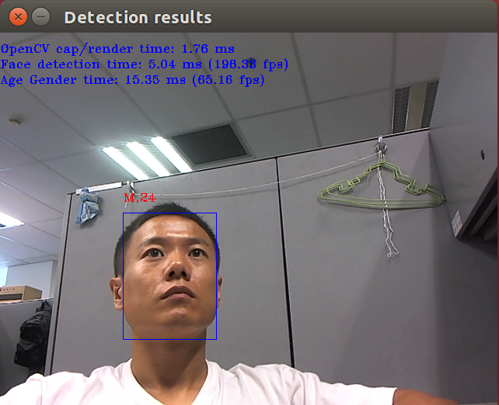
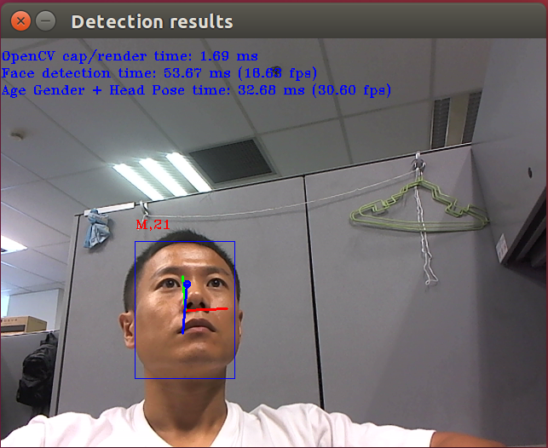
Lab5-2: Face Detection Demo
MYRIAD):

Slide 31
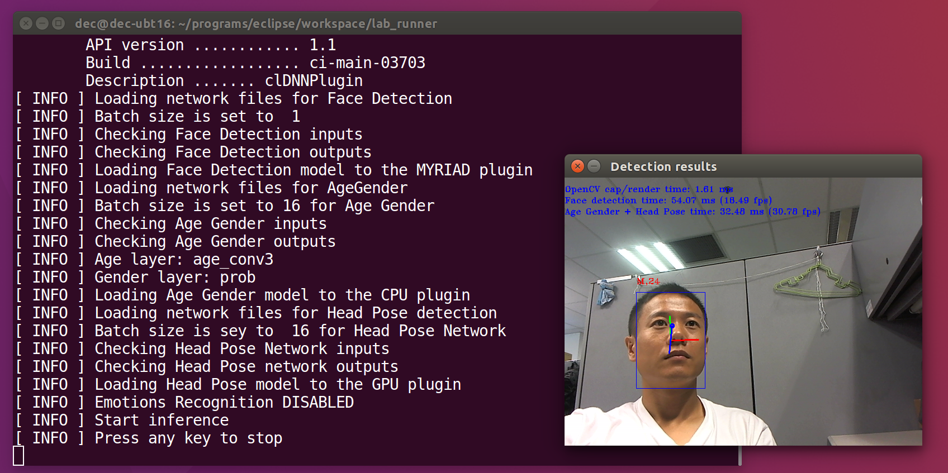
Lab5-2: Face Detection Demo
Try below cmd and run the demo (press any key to quit app)
./lab.py interactive_face_detection_sample -i /dev/video0 -m FP16/face-detection-retail-0004 -d MYRIAD -m_ag age-gender-recognition-retail-0013 -d_ag CPU -m_hp head-pose-estimation-adas-0001 -d_hp GPU

